Slide 1
Stereo
Some slides from Richard Szeliski George Bebis and Steve Seitz

Slide 2
What is Computational Stereo?
Viewing the same physical point from two different viewpoints allows depth from triangulation

Slide 3
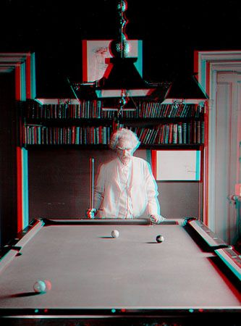
Mark Twain at Pool Table", no date, UCR Museum of Photography

Slide 4
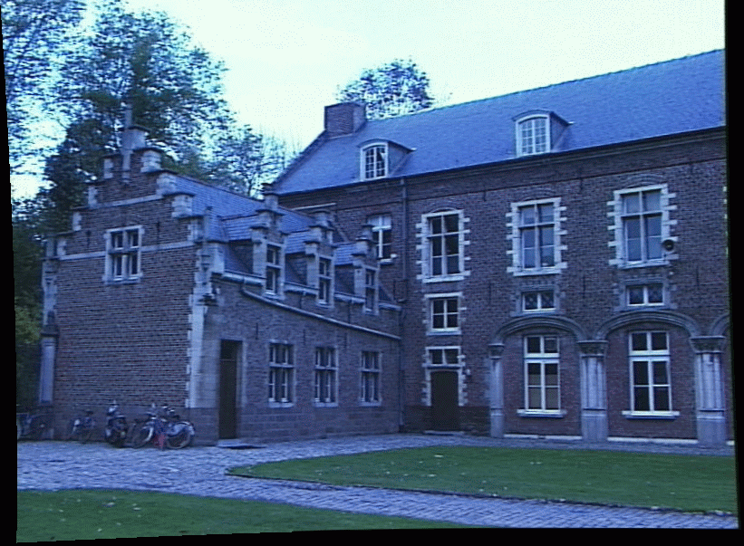
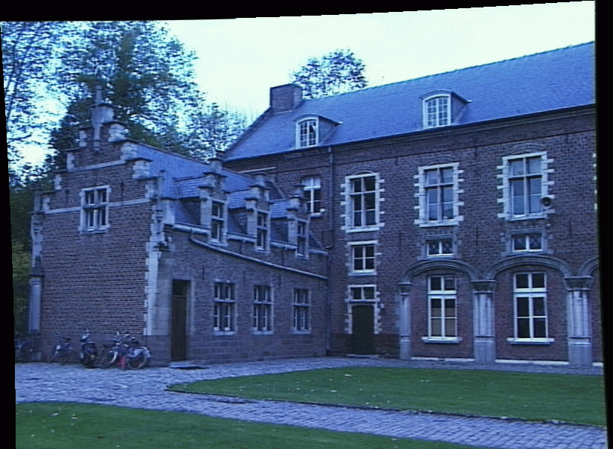
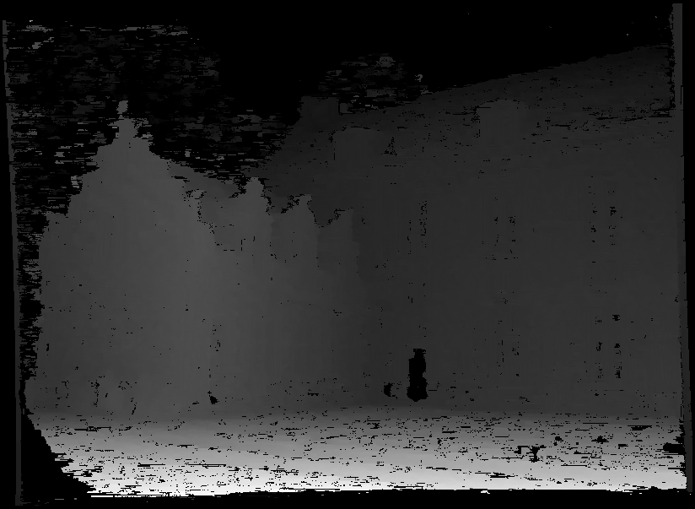
Binocular stereo
Given a calibrated binocular stereo pair, fuse it to produce a depth image
image 1
image 2
Dense depth map

Slide 5
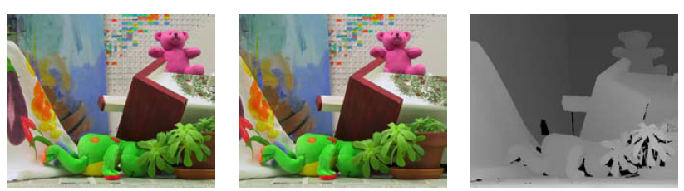
Depth from Stereo
Left image
Right image
Depth map

Slide 6
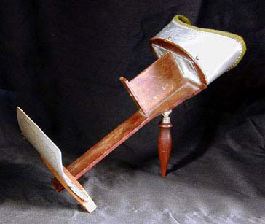
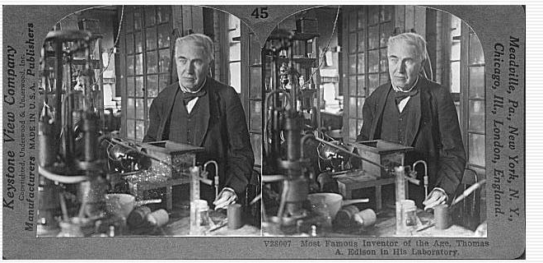
Binocular stereo
Given a calibrated binocular stereo pair, fuse it to produce a depth image
Humans can do it
Stereograms: Invented by Sir Charles Wheatstone, 1838

Slide 7
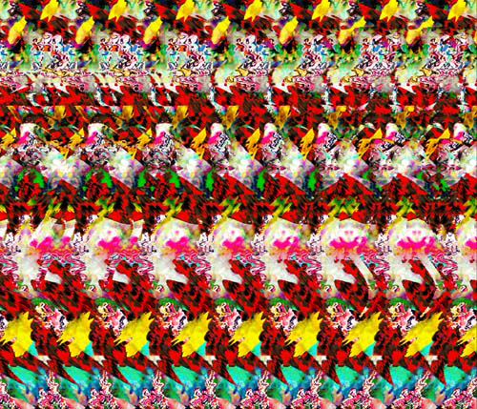
Binocular stereo
Given a calibrated binocular stereo pair, fuse it to produce a depth image
Humans can do it
Autostereograms: www.magiceye.com

Slide 8
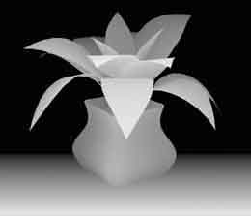
Binocular stereo
Given a calibrated binocular stereo pair, fuse it to produce a depth image
Autostereograms: www.magiceye.com

Slide 9
Stereo Matching
Given two or more images of the same scene or object, compute a representation of its shape
What are some possible applications?
?

Slide 10
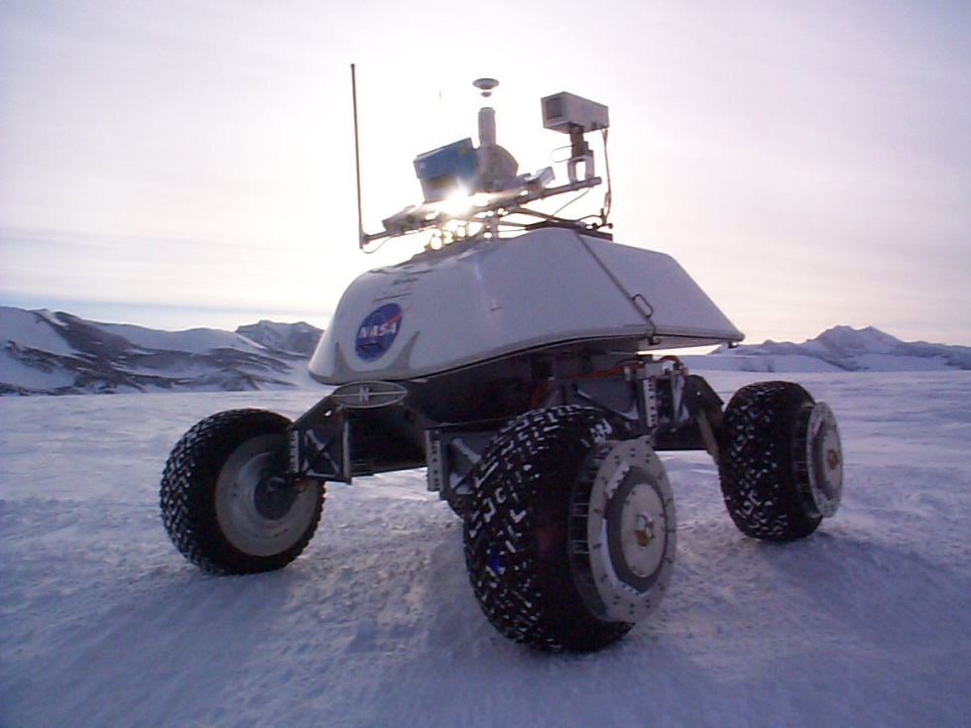
Real-time stereo
Nomad robot searches for meteorites in Antartica
http://www.frc.ri.cmu.edu/projects/meteorobot/index.html
Used for robot navigation (and other tasks)
Software-based real-time stereo techniques

Slide 11
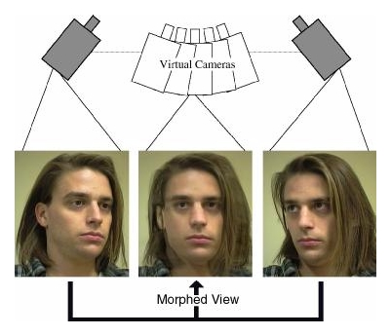
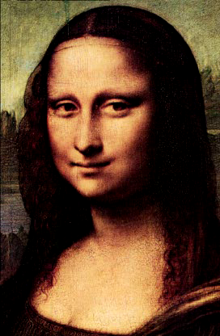
View Morphing
Morph between pair of images using epipolar geometry [Seitz & Dyer, SIGGRAPH’96]

Slide 12
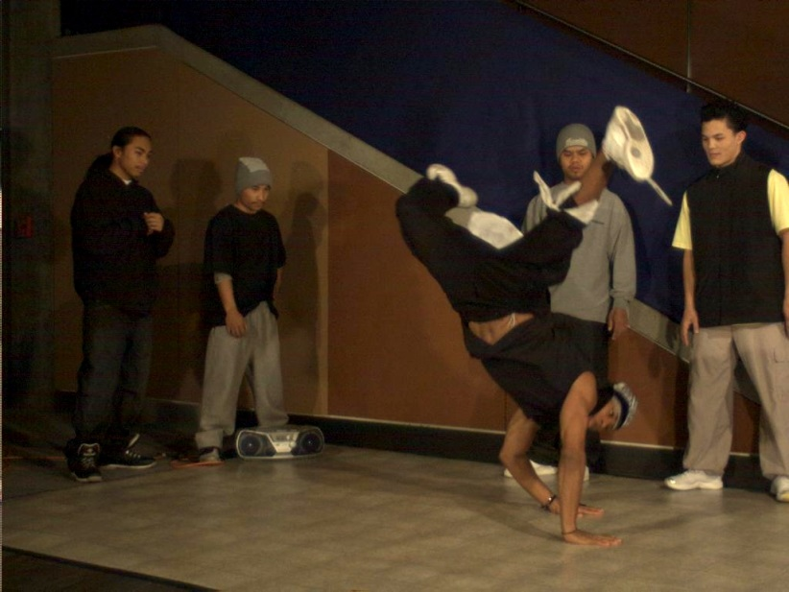
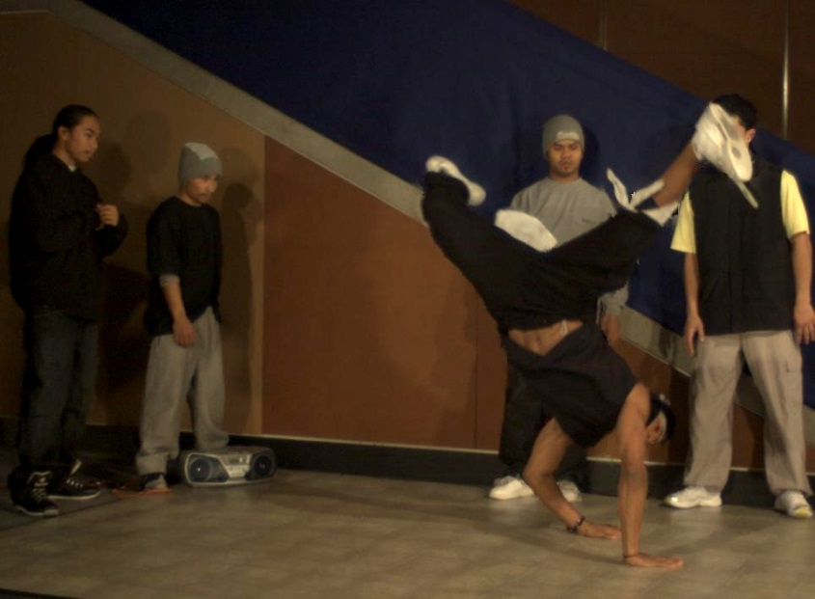
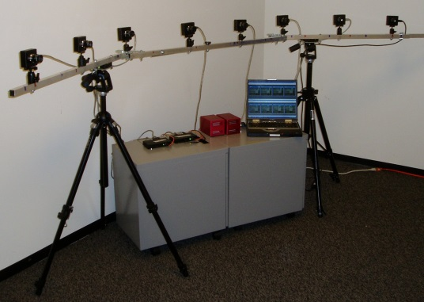
Video view interpolation

Slide 13
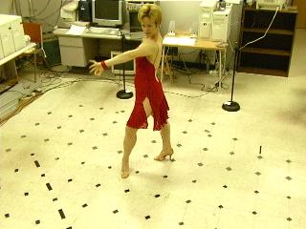
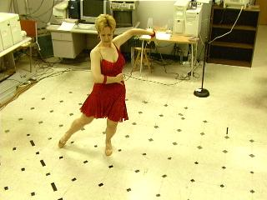
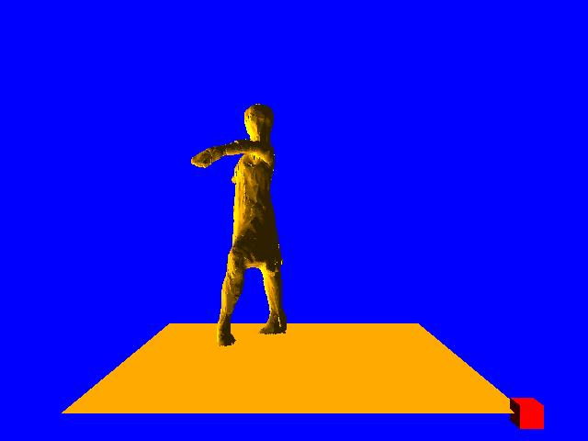
Virtualized RealityTM
[Takeo Kanade et al., CMU]
collect video from 50+ stream
reconstruct 3D model sequences
steerable version used for SuperBowl XXV “eye vision”
http://www.cs.cmu.edu/afs/cs/project/VirtualizedR/www/VirtualizedR.html

Slide 14
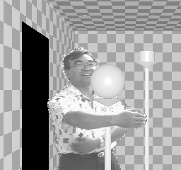
Z-keying: mix live and synthetic
Takeo Kanade, CMU (Stereo Machine)

Slide 15
Why Stereo Vision?
2D images: Project 3D points into 2D
P
Q
P’=Q’
O
3D Points on the same viewing line have the same 2D image:
2D imaging results in depth information loss

Slide 16
Stereo
Assumes (two) cameras.
Known positions.
Recover depth.
2 Step: 1.) Find correspondences
2.) Reconstruct (through triangulation)

Slide 17
Recovering Depth Information:
P
Q
P’₁
P’₂=Q’₂
Q’₁
O₂
O₁
Depth can be recovered with two images and triangulation.

Slide 18
Finding Correspondences:
P
Q
P’₁
P’₂ Q’₂
Q’₁
O₂
O₁

Slide 19
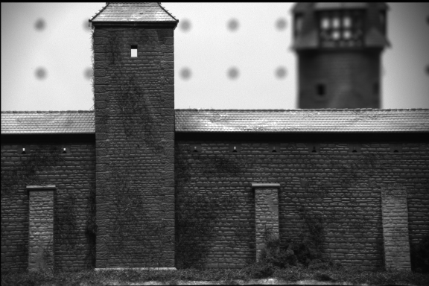
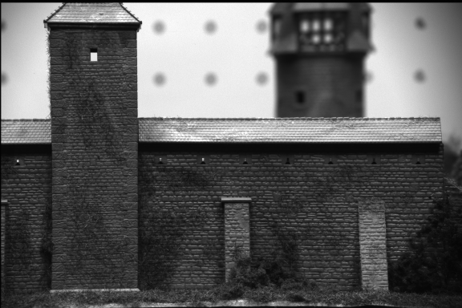
Finding Correspondences:

Slide 20
3D Reconstruction
P
P’₁
P’₂
O₂
O₁
We must solve the correspondence problem first!

Slide 21
Stereo setup
Cameras in arbitrary position
and orientation:
More convenient setup:

Slide 22
Stereo correspondence (cameras in arbitrary position)
Determine Pixel Correspondence
Pairs of points that correspond to same scene point
epipolar line
epipolar line
epipolar plane
Epipolar Constraint
Reduces correspondence problem to 1D search along conjugate epipolar lines
(Seitz)

Slide 23
Simplest Case: Parallel images
Image planes of cameras are parallel to each other and to the baseline
Camera centers are at same height
Focal lengths are the same

Slide 24
Simplest Case: Parallel images
Image planes of cameras are parallel to each other and to the baseline
Camera centers are at same height
Focal lengths are the same
Then epipolar lines fall along the horizontal scan lines of the images

Slide 25
We can always achieve this geometry with image rectification
Image Reprojection
reproject image planes onto common plane parallel to line between optical centers
Notice, only focal point of camera really matters
(Seitz)

Slide 26
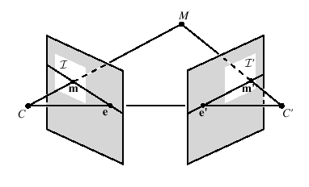
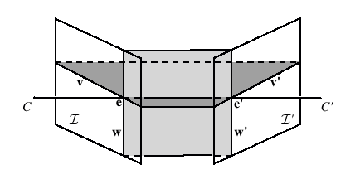
Rectification
Project each image onto same plane, which is parallel to the epipole
Resample lines (and shear/stretch) to place lines in correspondence, and minimize distortion
[Zhang and Loop, MSR-TR-99-21]

Slide 27
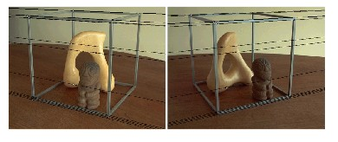
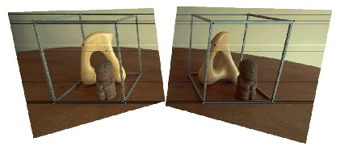
Rectification example

Slide 28
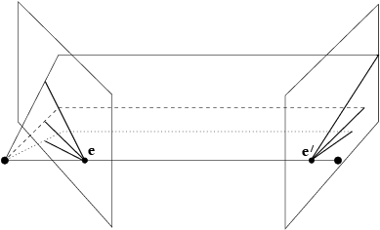
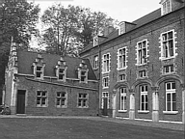
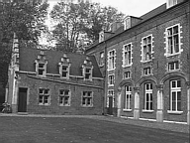
Example
courtesy of Marc Pollefeys

Slide 29
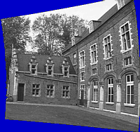
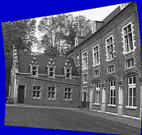
Epipolar Line Example
courtesy of Marc Pollefeys

Slide 30
Rectification (cont’d)
Main steps
(assuming knowledge of the extrinsic/intrinsic stereo parameters):
(1) Rotate the left camera so
that the epipolar lines become
parallel to the horizontal axis
(i.e., epipole is mapped to infinity).

Slide 31
Rectification (cont’d)
(2) Apply the same rotation to
the right camera to recover the
original geometry.
(3) Align right camera with left camera using rotation R.
(4) Adjust scale in both camera frames.

Slide 32
Rectification (cont’d)
Consider step (1) only (i.e., other steps are easy):
Construct a coordinate system (e₁, e₂, e₃) centered at O_{l} .
Aligning it with image plane coordinate system.

Slide 33
Rectification (cont’d)
(1.1) e₁ is a unit vector along the vector T (baseline)

Slide 34
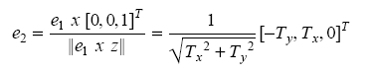
Rectification (cont’d)
(1.2) e₂ must be perpendicular to e₁ (i.e., cross product of e₁ with the optical axis)
z=[0,0,1]^{T}

Slide 35
Rectification (cont’d)
(1.3) choose e₃ as the cross product of e₁ and e₂

Slide 36
Rectification (cont’d)
The rotation matrix that maps the left epipole to infinity is the
transformation that aligns (e₁, e₂, e₃) with (i ,j, k):

Slide 37
Depth from disparity
X
z
x
x’
f
B₁
B₂
f
O
Baseline B
O’
Disparity is inversely proportional to depth!

Slide 38
Correspondence Problem
Two classes of algorithms:
Correlation-based algorithms
Produce a DENSE set of correspondences
Feature-based algorithms
Produce a SPARSE set of correspondences

Slide 39
Stereo Vision
Distance is inversely proportional to disparity
closer objects can be measured more accurately
Disparity is proportional to baseline
For a given disparity error, the accuracy of the depth estimate increases with increasing baseline
However, as the baseline is increased, some objects may appear in one camera, but not in the other.
Image resolution is also a factor

Slide 40
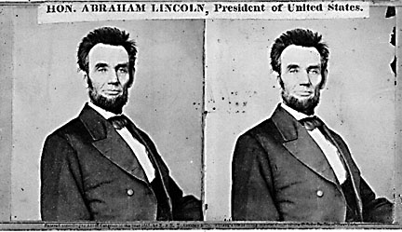
Using these constraints we can use matching for stereo
For each epipolar line
For each pixel in the left image
compare with every pixel on same epipolar line in right image
pick pixel with minimum match cost
This will never work, so:
Improvement: match windows

Slide 41
Basic stereo matching algorithm
If necessary, rectify the two stereo images to transform epipolar lines into scanlines
For each pixel x in the first image
Find corresponding epipolar scanline in the right image
Examine all pixels on the scanline and pick the best match x’
Compute disparity x–x’ and set depth(x) = B*f/(x–x’)

Slide 42
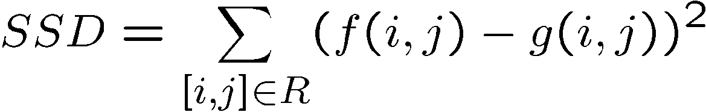
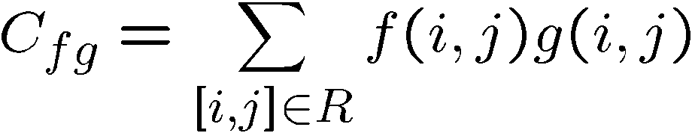
Comparing Windows:
?
=
f
g
Most
popular
For each window, match to closest window on epipolar line in other image.

Slide 43
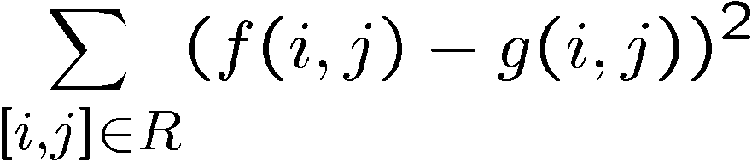
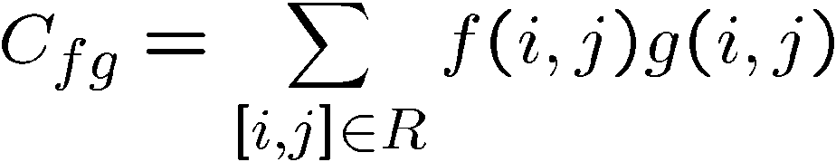
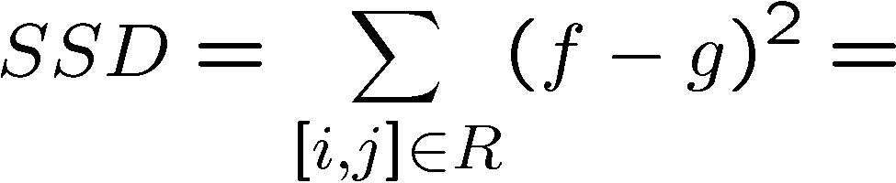
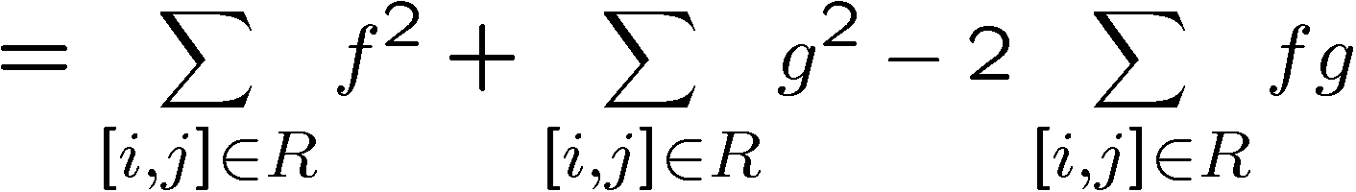
Minimize
Sum of Squared
Differences
Maximize
Cross correlation
It is closely related to the SSD:

Slide 44
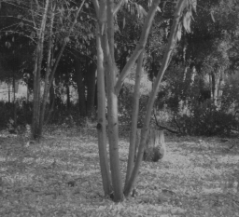
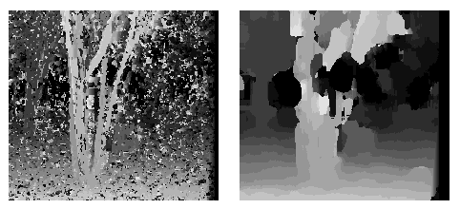
Effect of window size
W = 3
W = 20
Smaller window
More detail
More noise
Larger window
Smoother disparity maps
Less detail
Notes:
smaller window: more detail, more noise
bigger window: less noise, more detail

Slide 45

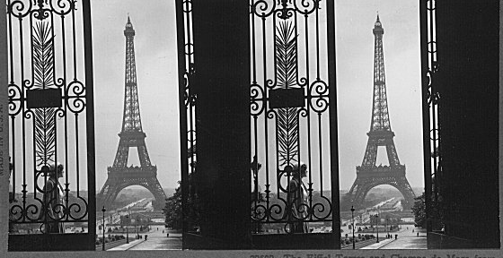
Failures of correspondence search
Textureless surfaces
Occlusions, repetition
Non-Lambertian surfaces, specularities

Slide 46
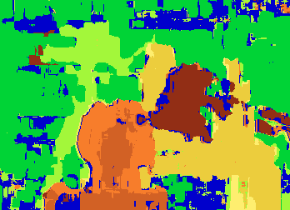

Results with window correlation
Window-based matching
(best window size)
Ground truth
(Seitz)

Slide 47
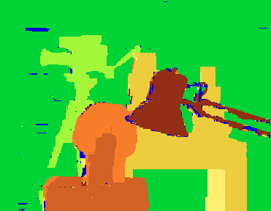
Results with better method
Graphcut method
Y. Boykov, O. Veksler, and R. Zabih,
Fast Approximate Energy Minimization via Graph Cuts,
PAMI 2001
Ground truth

Slide 48
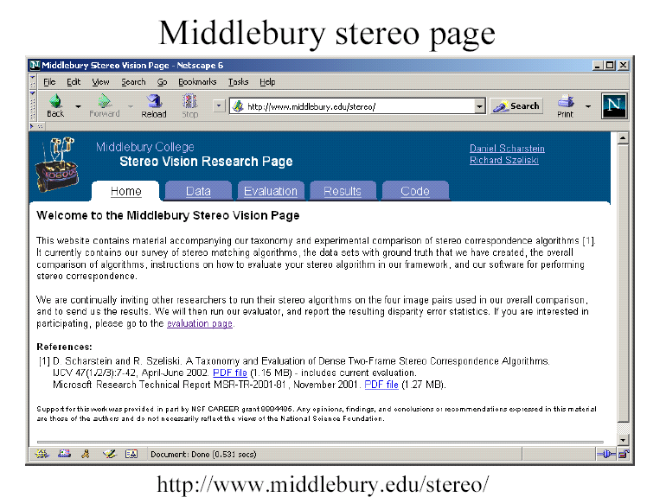
http://vision.middlebury.edu/stereo/

Slide 49
How can we improve window-based matching?
The similarity constraint is local (each reference window is matched independently)
Need to enforce non-local correspondence constraints

Slide 50
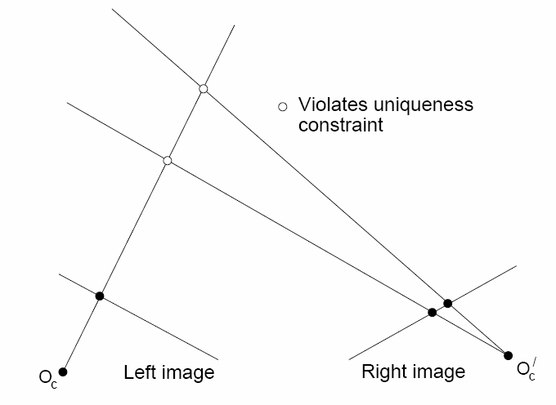
Non-local constraints
Uniqueness
For any point in one image, there should be at most one matching point in the other image

Slide 51
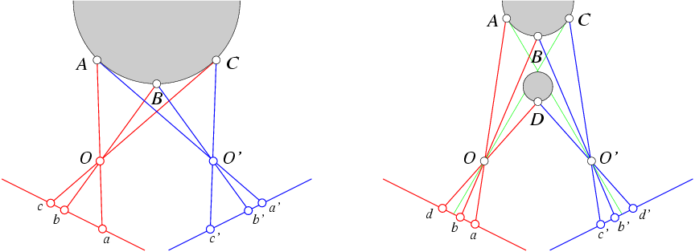
Non-local constraints
Uniqueness
For any point in one image, there should be at most one matching point in the other image
Ordering
Corresponding points should be in the same order in both views

Slide 52
Non-local constraints
Uniqueness
For any point in one image, there should be at most one matching point in the other image
Ordering
Corresponding points should be in the same order in both views
Ordering constraint doesn’t hold

Slide 53
Non-local constraints
Uniqueness
For any point in one image, there should be at most one matching point in the other image
Ordering
Corresponding points should be in the same order in both views
Smoothness
We expect disparity values to change slowly (for the most part)
Unfortunately, this makes the problem 2D again.
Solved with a host of graph algorithms, Markov Random Fields, Belief Propagation, ….

Slide 54
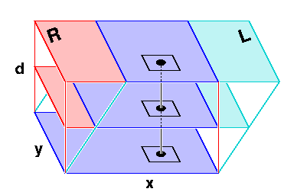
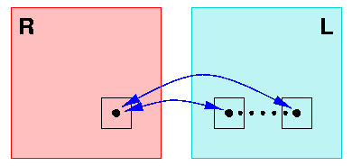
Data structure for keeping track of matching cost
for every pixel, for every disparity for every disparity for every pixel compute cost compute cost

Slide 55
Scanline stereo
Try to coherently match pixels on the entire scanline
Different scanlines are still optimized independently
Left image
Right image

Slide 56
“Shortest paths” for scan-line stereo
Left image
Right image
Right
occlusion
q
Left occlusion
correspondence
t
s
p
Can be implemented with dynamic programming
Ohta & Kanade ’85, Cox et al. ‘96
Slide credit: Y. Boykov

Slide 57
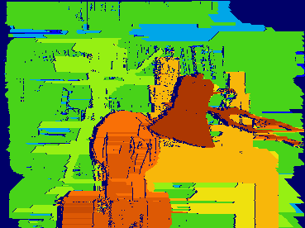
Coherent stereo on 2D grid
Scanline stereo generates streaking artifacts
Can’t use dynamic programming to find spatially coherent disparities/ correspondences on a 2D grid

Slide 58
Stereo matching as energy minimization
I₁
I₂
D
W₁(i )
W₂(i+D(i ))
D(i )
data term
smoothness term
Energy functions of this form can be minimized using graph cuts
Y. Boykov, O. Veksler, and R. Zabih, Fast Approximate Energy Minimization via Graph Cuts, PAMI 2001

Slide 59
Applications of Real-Time Stereo
Mobile robotics
Detect the structure of ground; detect obstacles; convoying
Graphics/video
Detect foreground objects and matte in other objects (super-matrix effect)
Surveillance
Detect and classify vehicles on a street or in a parking garage
Medical
Measurement (e.g. sizing tumors)
Visualization (e.g. register with pre-operative CT)

Slide 60
Real-time Stereo:
Obstacle detection
Ground plane detection

Slide 61
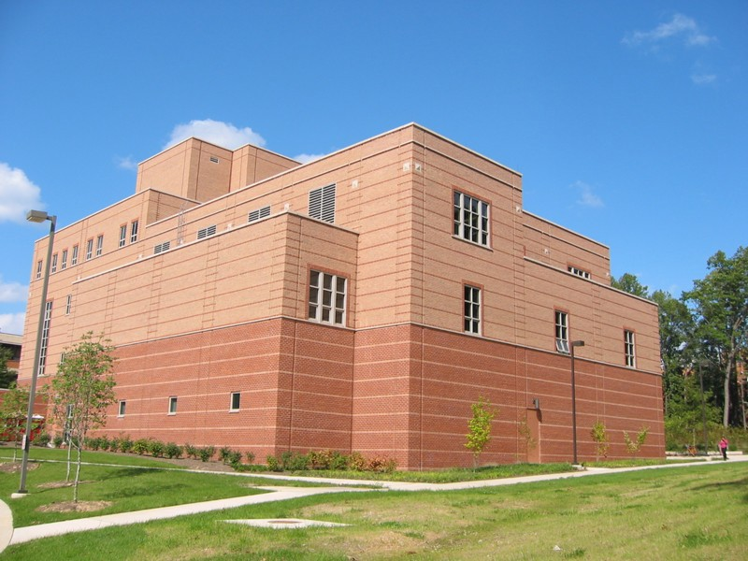





Reconstruction of building
3D model

Slide 62






Oxford corridor
using 6 images
3D model

Slide 63
Feature based stereo
Instead of matching each pixel
Match features in the image
What are good features ?
Examples of features – line matching, point matching region matching

Slide 64


Active stereo with structured light
Project “structured” light patterns onto the object
Simplifies the correspondence problem
Allows us to use only one camera
camera
projector
L. Zhang, B. Curless, and S. M. Seitz. Rapid Shape Acquisition Using Color Structured Light and Multi-pass Dynamic Programming. 3DPVT 2002

Slide 65

Active stereo with structured light
L. Zhang, B. Curless, and S. M. Seitz. Rapid Shape Acquisition Using Color Structured Light and Multi-pass Dynamic Programming. 3DPVT 2002

Slide 66
Active stereo with structured light
http://en.wikipedia.org/wiki/Structured-light_3D_scanner

Slide 67


Kinect: Structured infrared light
http://bbzippo.wordpress.com/2010/11/28/kinect-in-infrared/

Slide 68

Kinect 1
Kinect uses a speckle pattern of dots that are projected onto a scene by means of an IR projector, and detected by an IR camera.
Each IR dot in the speckle pattern has a unique surrounding area and therefore allows each dot to be easily identified when projected onto a scene. The processing performed in the Kinect in order to calculate depth is essentially a stereo vision computation.

